Slide 1
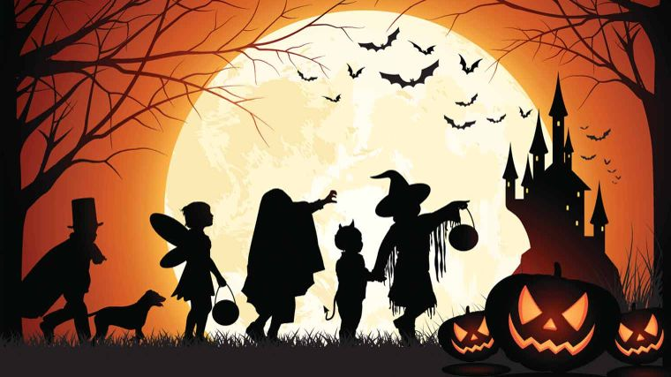
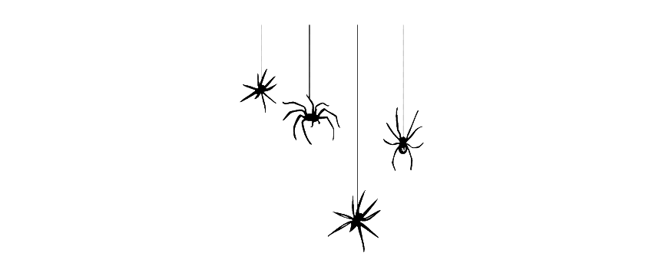
Happy Halloween!

Slide 2
Some new words:
Willfull
Abrupt
Wearing
Sloppy
wholehearted

Slide 3
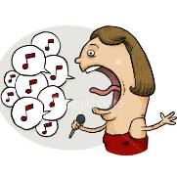
What type of words are the green words?
What do they have in common?
The has a beautiful voice.
This movie has an abrupt end.
There is a light layer of powdered sugar on the brownies.

Slide 4
Adjectives
Function: They often Adds something to a noun
They often say something about that noun.
The has a beautiful voice.
This movie has an abrupt end.
There is a light layer of powdered sugar on the brownies.

Slide 5
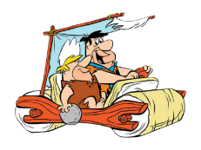
What is changing here?
Does it add something to the action?
The girl sings.
The girl sings beautifully.
I thought the movie ended.
I thought the movie ended abruptly.
She dusted the brownies with some powdered sugar.
She lightly dusted the brownies with some powdered sugar.

Slide 6
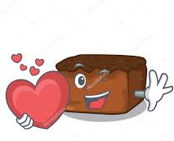
To what type of word do these words add something?
What do they have in common?
Beautiful: The girl sings beautifully
Abruptly: I thought the movie ended abruptly.
Lightly: She lightly dusted the brownies with some powdered sugar.

Slide 7
Adverbs
Function: They often add something to a verb (!)
They often tell you how something happened
The singer sings beautifully
I thought the movie ended abruptly.
She lightly dusted the brownies with some powdered sugar.

Slide 8
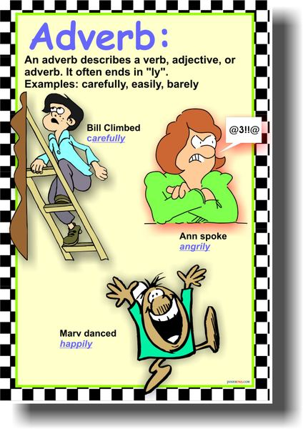

Slide 9
Let’s look at some more:
Truthful: She truthfully answered the police officer's questions.
Quick: Quickly finish the grocery shopping so we can get to the party in time.
Weary: At the end of a long day, she quickly headed to bed.
Willful: I sent my son to bed early for willfully refusing to eat his vegetables.

Slide 10
Let’s have a closer look:
How do we usually form an adverb?
Abrubt: ( adj)
I thought the movie ended abruptly.
Light: ( Adj)
She lightly dusted the brownies with some powdered sugar.
Rule: adjective + ly
Adj ends in y => ily.
Ex: easy -- easily
Adj. Ends on le => ly.
Ex.: terrible -- terribly
Adj. Ends in ic => ically.
Ex.: Ironic => Ironically
Some adjectives do not change:
Ex.: fast -- fast
long -- long
hard -- hard
Irregular adverbs:
Vb. good -- well

Slide 11
Look at different adverbs:
Could you group them? What type of thing they add to the verb?
1Time/ 2 how something happend / 3 place
1 Kristen quickly walked to the library, eager to complete her homework.
2 When I clean, I do the laundry last.
3 It was completely clear he was not interested in hearing my opinion.
4 When it's hot and humid, Anna likes to read inside.
5 Jack looked everywhere for his missing keys.
6 I love to randomly share interesting trivia with my friends and family.
7 I will stop by later to see how you are doing

Slide 12
Look at some of these again:
Could you group them? What type of thing do they add to the verb?
Adverbs that tell you how something happened;
1 Kristen quickly walked to the library, eager to complete her homework.
3 It was completely clear he was not interested in hearing my opinion.
6 I love to randomly share interesting trivia
Adverbs of place :
4 When it's hot and humid, Anna likes to read inside.
5 Jack looked everywhere for his missing keys
Adverbs of time:
2 When I clean, I do laundry last.
7 I will stop by later to see how you are doing

Slide 13
Adverbs of time
Indicators of time:
Always never ever still
Almost even just oft
Well fast hardly

Slide 14
Adverbs vs adjectives
Adverbs add something to a verb, adverb or an adjective
Depending on the original ending:
Adjective + ly
Adjective + ily
Adjective + ically
Adjectives add something to a noun.
The crazy lady sings beautifully

Slide 15
Now try to make some Adverbs for yourself:
Quick: Kristen ………………… walked to the library, eager to complete her homework.
Complete: It was ……………….clear he was not interested in hearing my opinion.
Cheerful: April …………………… greeted Mark each morning.
Expert: Adam ………………. maneuvered the components of the machine into their proper positions.
Random: I love to…………………….. share interesting trivia with my friends and family.
Sloppy: He writes …………….. but insists his ideas are more important than having perfect penmanship.
Uneasy: Jemma sighed …………….. knowing that the dark sky was a sign of the impending storm.
Weird: She dances ………………….., but her quirky personality is what I love the most.
Wholehearted: I ………………………… believe education is the key to a better future.
Wicked: "I don't think you want to know the whole story," he said ………………….

